Slide 1

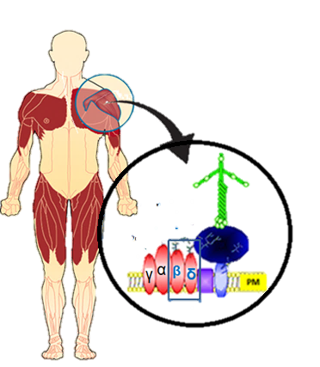
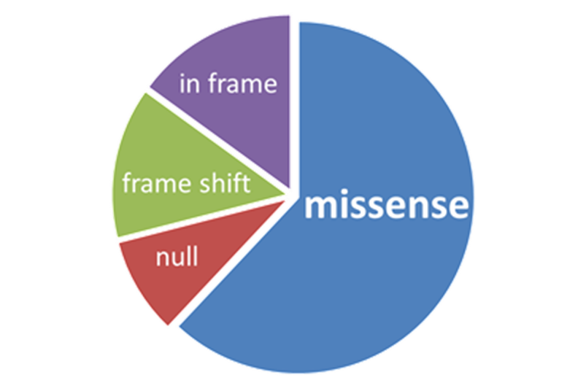
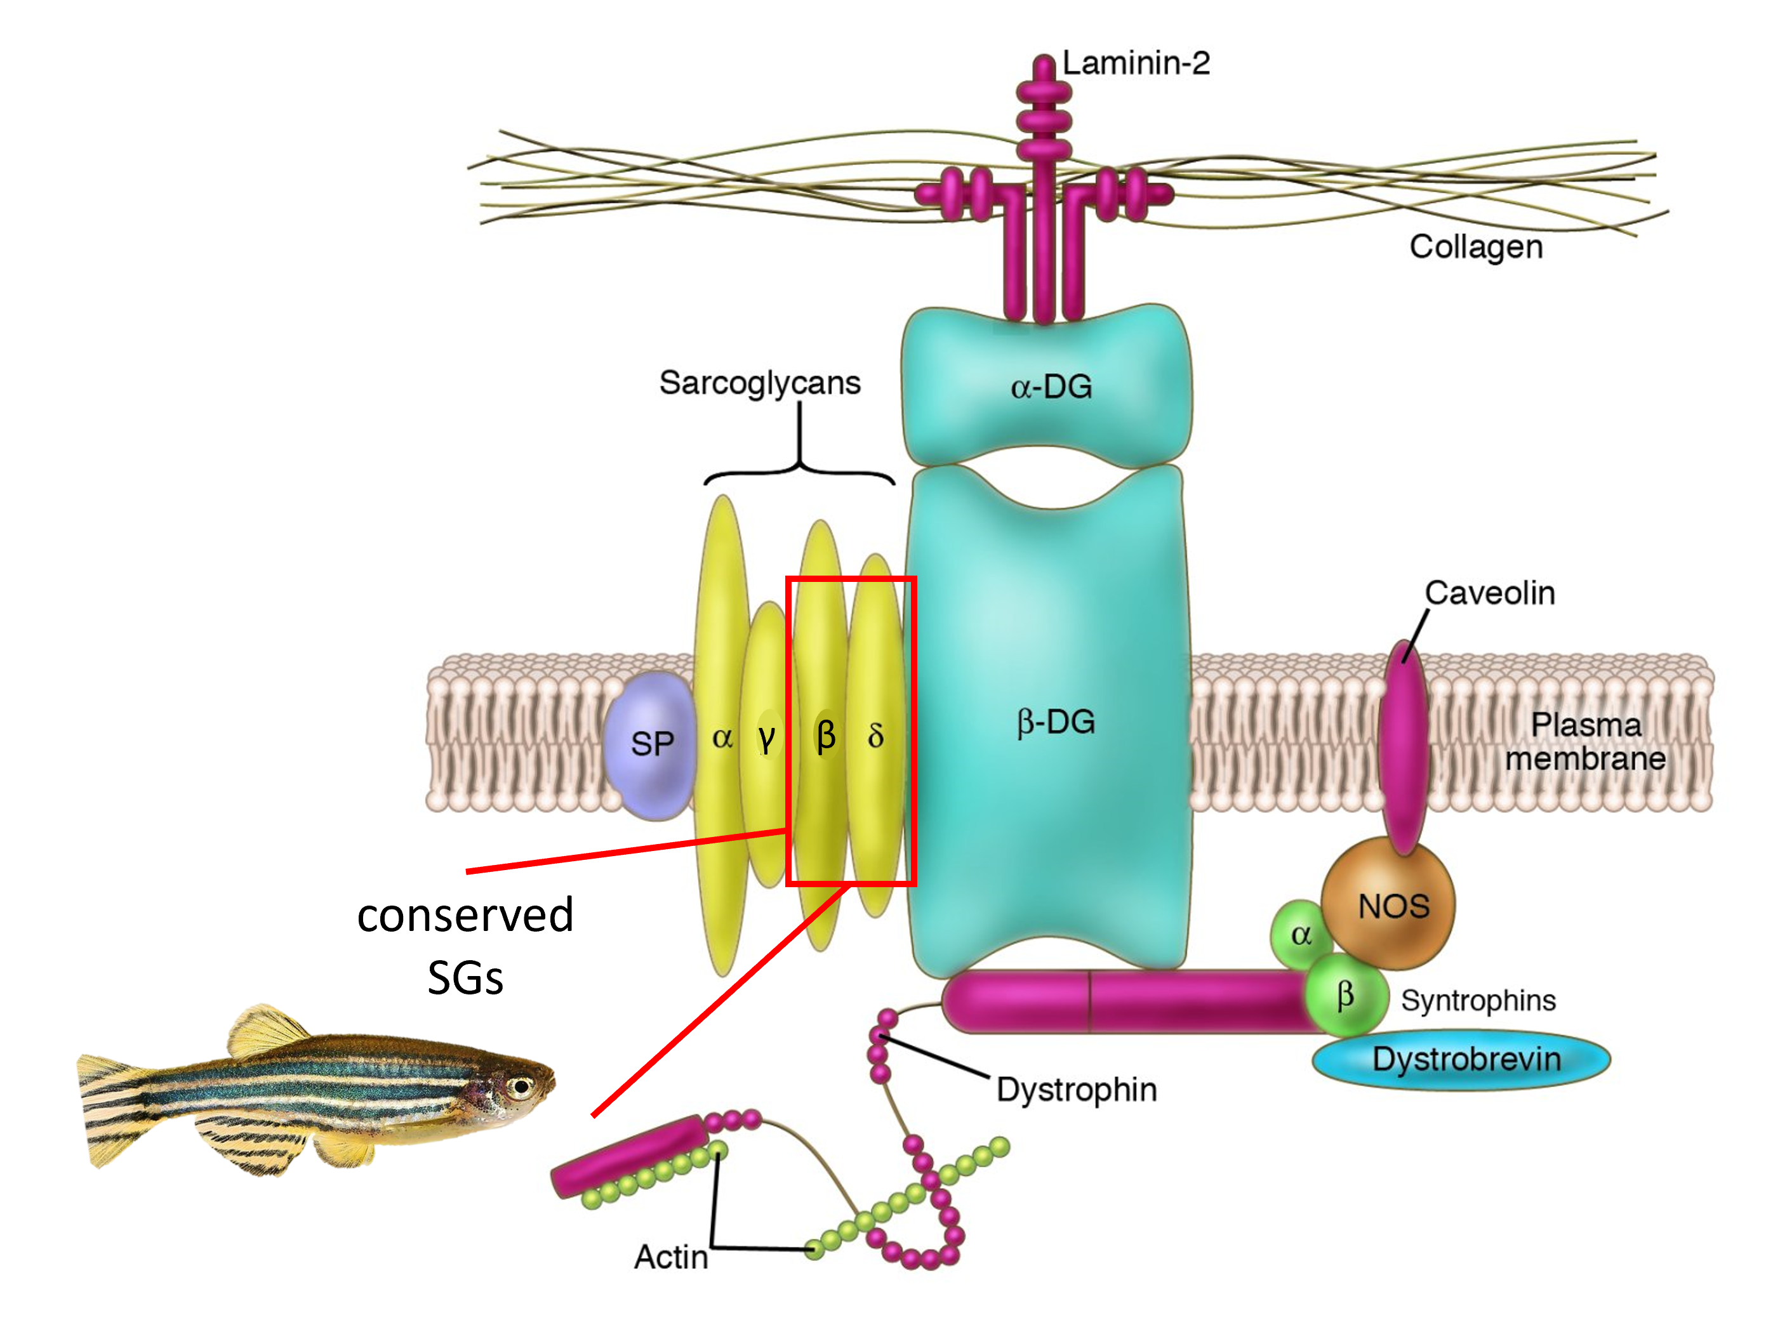
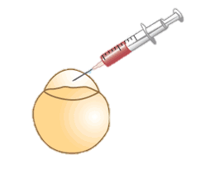
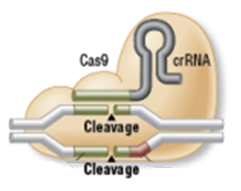
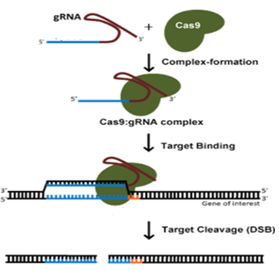
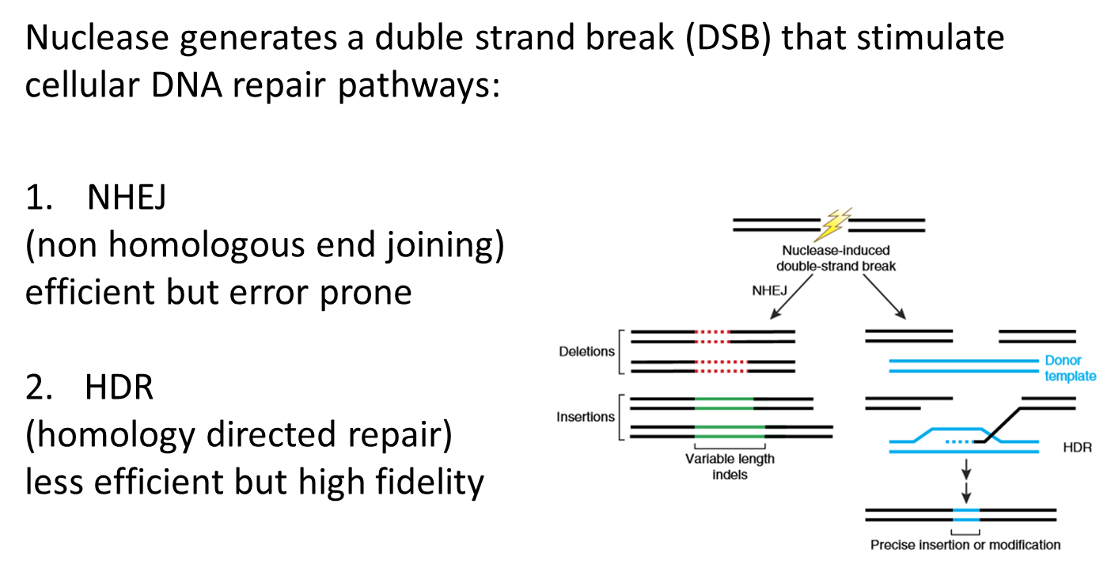
Zebrafish as a model for sarcoglycanopathies:
in-depth analysis of the disease phenotype
Francesco Dalla Barba¹; Michela Soardi¹; Martina Scano¹; Alberto Benetollo¹; Marcello Carotti¹; Paola Caccin¹; Giovanni Risato²; Francesco Argenton²; Dorianna Sandonà¹, ¹Dept. Biomedical Sciences, ²Dept. Biology, University of Padova, Italy.
Sarcoglycanopathy and zebrafish as a model for the screening of novel drugs
Four rare autosomal recessive diseases.
Prevalence 1/200’000.
Characterized by limb-girdle muscle weakness, calf hypertrophy, diaphragmatic weakness, variable cardiac involvement.
Due to mutations in genes coding for sarcoglycans (SG).
The pathogenic mechanism has been disclosed ^{1,2,3,4}.
α-, β-, γ- and δ-SG form a tetramer at the sarcolemma of striated muscle, to assure structural stability during muscle contraction.
Mutations in any SG gene lead to a loss/ reduction of mutated SG and WT partners.
SG-complex disruption results in progressive muscle degeneration.
SG-Knock Out zebrafish could be valuable models of sarcoglycanopathy, useful for screening of novel as well as known compounds able to recover the main dystrophic features.
No effective therapy available
Zebrafish models of Sarcoglycanopathy
The CRISPR/Cas9 genome editing technique can be adopted to produce a permanent modification of the genome at a predetermined locus; both KO and KI can be generated.
β-SG (sgcb ^{-/-}) and δ-SG (sgcd ^{-/-}) knock out zebrafish lines have been generated. First characterization evidenced a very mild phenotype at embryonic and larval stages.
A double SG-KO (DKO) line (sgcb ^{-/-}/sgcd ^{-/-}) was generated by crossing the single SG-KO zebrafish.
CRISPR/Cas9 Inj.
Target β or δ SG genes
Like in human, zebrafish muscle presents at the sarcolemma the key proteins of the Dystrophin Glycoprotein complex.
β- and δ-SG are the most conserved SGs.
β-SG (coded by z-scgb) is 75% identical and 87% similar and δ-SG (coded by z-sgcd) is 72% identical and 87% similar to the human orthologues.
Repair
NHEJ
Alteration in the reading frame: KO
Characterization of zebrafish mutants
Birefringence is a physical property in which light is rotated as it passes through ordered matter, such as the pseudo-crystalline array of muscle sarcomeres.
A decrease in the intensity of light could be indicative of the alteration of the sarcomeric structure.
The presence of dark spots suggests the disorganization or loss of muscle fibers⁵.
Larvae locomotion assay
A
B
Phalloidin is a toxin that binds F-actin, if conjugated to a fluorescent dye (Alexa Fluor® 488) allows to visualize the cytoskeleton of muscle fibres.
sgcd ^{-/-} zebrafish sarcomere organization presents no significant difference in comparison to wild type. The v-shaped myosepta structure is slightly wavy in comparison to the wild type one (white arrows). Bar: 50 um.
The swimming ability of zebrafish mutants was evaluated subjecting larva (5dpf), to alternating 10 min light–dark periods. Grey and white area signify dark and light conditions, respectively. Distance moved is measured (in mm) in 2-min intervals throughout the experiment. The overall behavior of the four genotypes is similar, even though the performance of mutants seems impaired, especially in the case of the DKO.
When total distance moved by larvae is plotted, the reduced swimming capacity is confirmed for all mutant, with the DKO larvae presenting the severest impairment.
Sarcomeres appear brilliant in WT as well as in the single SG-KO fish, with only a few dark myotomes in mutants. On the contrary, the DKO line (sgcb ^{-/-}/sgcd ^{-/-}) presents a general decreased birefringence and dark patches distributed along the larval body, both are signs of a significant disorganization of muscle fibres.
Kaplan-Meier curve for sgcd ^{-/-} and wild type zebrafish.
Survival rate up to 12-15 dpf is similar for both genotypes while at 60 dpf is 57,6% for the wild type and only 18,6% for the sgcd ^{-/-} line, grew at the same conditions.
Consequences of SGs deletion on zebrafish heart
Heart rate of larvae at 6 dpf.
Mutant zebrafish present a slower heartbeat then WT, that however is statistically significant for DKO only.
H&E of adult zebrafish heart ventricle.
Cortical layer (compact myocardium) of sgcd ^{-/-} appears less homogenous and thicker than the WT one (black arrows).
The trabecular myocardium of sgcd -/- is compact and thicker compared to wild type. Bar: 100 um.
The absence of a single SG impacts on muscle, heart and survival in a progressive manner, with embryos/larvae presenting a very mild phenotype.
The DKO zebrafish presents severe signs of myopathy since the first days of development.
The early dystrophic phenotype, although deserving further characterization, makes DKO an optimal animal model for the screening of new drugs.
¹Gastaldello, AJP 2008; ²Bartoli, Hum Mol Genet 2008; ³Soheili, Hum Mutat 2012; ⁴Bianchini, Hum Mol Genet 2014⁵ Guyon, BBA 2007
Funded by: MDA (Muscolar dystrophy association); Italian Telethon, AFM (Association française contre les myopathies)

